Slide 1

1st REVIEW · OPERATING SYSTEMS AND SYSTEMS PROGRAMMING (25CS2104E) · 2026–27, Term-I
High-Concurrency File Distribution Server
C · POSIX threads · mutexes & semaphores · mmap() · TCP sockets · Ubuntu
Roll Number | Student Name
2520030278 | Y. Venkata Sai
2520030318 | B. Ram Charan
2520030407 | D. Tejas
Section 5 · Team 8
KONERU LAKSHMAIAH EDUCATION FOUNDATION

Slide 2
GROUP NUMBER: 8
Name of Candidate | Roll Number | Role
Y. Venkata Sai | 2520030278 | Server core: sockets, thread pool, request queue
B. Ram Charan | 2520030318 | mmap file cache, logging, monitoring, signals
D. Tejas | 2520030407 | Client, load testing, debugging, documentation
2

Slide 3
ABSTRACT
The High-Concurrency File Distribution Server is a multithreaded server written in C that distributes large files to many clients over TCP.
Accepts many client connections concurrently
A pool of worker threads serves requests from a synchronized queue
Mutexes and semaphores protect all shared data
mmap() maps large files so the kernel handles paging, avoiding extra copies in user space
Simultaneous requests for the same file share one mapping
Download and client activity logs, live monitoring, signal-based control and shutdown
Key Flow: ACCEPT → QUEUE → WORKER → mmap → SEND → LOG
3

Slide 4
INTRODUCTION
A university distributes lecture videos, PDFs, lab manuals and software packages to thousands of students.
Many students often request the same popular file at the same time
Traditional copy operations use heavy CPU and I/O
Repeated read() into user buffers wastes memory and time
Server needs safe concurrency, low overhead and clean shutdown
The project applies threads, synchronization, memory mapping, file systems, sockets, signals and system calls
4

Slide 5
EXISTING SYSTEM
Limitations of traditional file-copy servers
One process or thread per request, or fully sequential serving
Each request re-reads the file and copies it through user buffers
Same file loaded repeatedly into memory for different clients
High CPU and I/O load under simultaneous requests
Little logging or resource monitoring; abrupt shutdown can break transfers
Main Gap: Bounded threads + shared file mapping + synchronization + monitoring
5

Slide 6
PROBLEM
The university needs a high-performance server that serves large files to many clients while minimizing unnecessary memory and I/O operations.
Concurrency: accept and serve many connections at once
Synchronization: shared queue, logs and counters without race conditions
Efficiency: avoid duplicate memory copies and repeated disk reads
Same-file requests: many clients, one file, safely shared
Control: monitor load and shut down gracefully with signals
Goal: A fast, safe and observable file distribution server in C
6

Slide 7
SOLUTION (Contribution)
Proposed design
Acceptor thread: accept() new TCP connections and enqueue requests
Bounded request queue: mutex-protected, with counting semaphores (items, slots)
Worker thread pool: dequeue, validate the file name, mmap() and send()
File table: reference-counted mappings shared across simultaneous requests
Logger and monitor threads: activity logs, connection and resource stats
Signal handling: SIGINT/SIGTERM shutdown, SIGUSR1 stats dump, SIGPIPE ignored
Flow: Client → Acceptor → Queue → Worker → mmap file → Client
7

Slide 8
OBJECTIVES
Accept multiple client connections concurrently
Process file requests with worker threads
Maintain a synchronized request queue
Protect shared resources with mutexes and semaphores
Access large files efficiently with mmap()
Transfer files to clients through TCP sockets
Keep download and client activity logs
Monitor active connections and resource consumption
Use signals for control and shutdown; handle simultaneous requests for the same file
8

Slide 9
MODULES
Module | Description
M1 Network Acceptor | socket(), bind(), listen(), accept(); creates request objects
M2 Request Queue | Circular buffer + mutex + sem_t items/slots (producer–consumer)
M3 Worker Pool | pthread workers: parse request, locate file, transfer
M4 File Manager | open(), fstat(), mmap(), munmap(); ref-counted shared mappings
M5 Transfer Engine | send() loop over the mapped region; handles partial sends and errors
M6 Logging | Download log and client-activity log, mutex-protected writes
M7 Monitor | Active connections, queue length, memory (getrusage, /proc)
M8 Signal Control | sigaction(): graceful shutdown, stats dump, ignore SIGPIPE
9

Slide 10
Architecture
Clients
(TCP)
Acceptor
thread
Request queue
mutex + sem
Worker
threads
mmap file
+ send()
Shared resources (each protected by its own lock)
File table
ref-counted maps
Logger
log mutex
Monitor thread
stats counters
Signal handler
SIGINT / SIGUSR1
Same file requested by many clients → one mmap() shared via reference count; last worker to finish calls munmap().
10

Slide 11
Syllabus Topics → Where Used (1/4)
CO | Syllabus topic | Where it is used in the project
CO-1 OS as a Service Layer | User space vs kernel space; system calls | Server runs in user space; socket(), accept(), open(), mmap(), send() enter the kernel. Verify: strace -c
 | Linux architecture & software stack | App → glibc/POSIX API → system calls → kernel (VFS, TCP/IP, memory manager) → hardware
 | Shell as a user-space program; command journey | Start with ./server 8080 from bash: shell does fork + exec. Ctrl+C and kill send signals
 | Systems programming fundamentals | C, Makefile, gcc -pthread, errno check after every system call
CO-2 Processes & Process Control | Process abstraction, lifecycle, states | Server is one process, workers are its threads. Watch states (R/S/D) with ps and top
 | Creation, execution, synchronization, termination | Shell creates the server; on shutdown pthread_join() all threads, then exit cleanly
 | Scheduling concepts | Workers compete for CPU; tune worker count against nproc; observe with top and nice
 | Process management pitfalls | Avoid zombies, leaked fds and threads; reap any child with waitpid() (optional logger process)
11

Slide 12
Syllabus Topics → Where Used (2/4)
CO | Syllabus topic | Where it is used in the project
CO-3 IPC & Signals | Signals & asynchronous notification | SIGINT/SIGTERM graceful shutdown, SIGUSR1 stats dump, SIGPIPE ignored on client disconnect
 | Signal handlers, POSIX signal programming | sigaction() with a volatile sig_atomic_t flag; handler only sets the flag
 | Anonymous pipes & named pipes (FIFOs) | Optional: mkfifo admin channel (echo stats > /tmp/fds_ctl); pipe() from workers to a logger
 | Process groups, sessions, job control | Run with &, use jobs / fg / bg; kill to the server PID; setsid for daemon mode (optional)
CO-4 Memory Management | Virtual memory, address translation, page tables | mmap() gives each file a virtual address range; kernel maps pages on demand
 | Page faults & demand paging | First touch of a mapped page faults it in. Measure ru_minflt / ru_majflt with getrusage()
 | Process address space layout | Inspect /proc/<pid>/maps: code, heap, thread stacks, mmap regions
 | Dynamic allocation, memory errors, debug tools | malloc/free for request objects; valgrind and -fsanitize=address; munmap when refs reach 0
 | Copy-on-write | MAP_PRIVATE read-only mapping shares pages; COW applies if fork() is used
12

Slide 13
Syllabus Topics → Where Used (3/4)
CO | Syllabus topic | Where it is used in the project
CO-5 File Systems & File I/O | Unix file abstraction, file descriptors | Files, sockets and logs are all fds; close every fd. Check: ls -l /proc/<pid>/fd
 | Inodes, directory entries, file naming | stat() for size and inode; opendir()/readdir() to list shared files; reject "../" names
 | VFS, ext4, Linux file I/O calls, buffered vs unbuffered | open/read/write/close through VFS to ext4 (df -T, ls -i); write() vs fprintf() for logs
 | Memory-mapped file I/O | mmap() + send() to transfer large files without extra user-space copies
CO-6 Concurrency & Synchronization | Threads vs processes, POSIX threads | pthread_create(): acceptor, worker pool, monitor thread
 | Race conditions & shared data; mutexes | Queue, file-table refcounts, counters and logs are shared: pthread_mutex_t on each
 | Counting semaphores | sem_t items/slots make the request queue a blocking bounded buffer
 | Condition variables, deadlocks, advanced sync | pthread_cond_t for shutdown wake-up; fixed lock order; test with helgrind
13

Slide 14
Syllabus Topics → Where Used (4/4)
CO | Syllabus topic | Where it is used in the project
CO-1 | OS as a layered service abstraction; kernel services | Server never touches hardware: app → glibc → system calls → kernel services (TCP/IP stack, VFS, memory manager, scheduler)
CO-3 | Inter-process communication (IPC) overview | Threads share memory (queue, counters); TCP sockets carry client ↔ server data; pipe()/FIFO for optional logger and admin channel
CO-4 | Address translation and page tables | Every mmap() page is translated by the MMU through page tables; first access faults; inspect with /proc/<pid>/smaps
CO-4 | Dynamic memory allocation in Linux | malloc() (brk/mmap underneath) for request objects: acceptor allocates, worker frees; one owner per object
CO-4 | Memory errors and OS responses | Bad pointer → SIGSEGV; file truncated while mapped → SIGBUS; mmap() ENOMEM / OOM killer. Check every return value
CO-4 | Memory debugging and analysis tools | valgrind, -fsanitize=address, pmap -x <pid>, free -h, VmRSS in /proc/<pid>/status
CO-5 | File descriptors and open file management | fd table → open file table → inode. close(fd) right after mmap(); raise ulimit -n for 100+ clients
CO-6 | Advanced synchronization concepts | pthread_rwlock_t for read-mostly file lookups; C11 atomics for connection counters; timed waits in monitor
CO-6 | Deadlocks and concurrency hazards | Lock order: queue → file table → log. Never hold a lock during send(). Check with helgrind
14

Slide 15
Project Modules → Syllabus Topics Used
Module | CO | Syllabus topics applied
M1 Network Acceptor | CO-1, CO-5 | System calls, kernel services, sockets as file descriptors
M2 Request Queue | CO-6 | Race conditions, mutex, counting semaphores (producer–consumer), deadlock avoidance
M3 Worker Pool | CO-2, CO-6 | POSIX threads, thread lifecycle, scheduling, pthread_join() termination
M4 File Manager | CO-4, CO-5 | mmap(), virtual memory, inodes via stat(), ref-count mutex, munmap(), memory errors
M5 Transfer Engine | CO-1, CO-4, CO-5 | send() system call, demand paging, partial sends, errno handling
M6 Logging | CO-3, CO-5, CO-6 | Buffered vs unbuffered I/O, mutex-protected writes, optional pipe() to logger
M7 Monitor | CO-4, CO-6 | getrusage() page faults, /proc statistics, monitor thread, condition variable
M8 Signal Control | CO-2, CO-3 | sigaction(), sig_atomic_t flag, SIGINT/SIGTERM/SIGUSR1/SIGPIPE, graceful termination
15

Slide 16
Logging, Monitoring & Testing
Logging
Monitoring
Testing
downloads.log: time, client IP, file, bytes, duration, status
activity.log: connect, disconnect, errors
One log mutex so lines never interleave
Flush on shutdown
Active connections and queue length counters
Memory use: getrusage(), /proc/self/status
Monitor thread prints stats every few seconds
kill -USR1 <pid> dumps stats on demand
External: htop, ss -tn, strace -c
Client program: ./client host port file
100+ clients: for i in $(seq 100); do ./client ... & done; wait
Compare files with sha256sum
helgrind for races, valgrind for leaks
Try Ctrl+C during transfers
16

Slide 17
Implementation Roadmap
Week | Task | Deliverable
1 | Repo, Makefile, single-thread TCP server and client | File transfer works
2 | Thread pool, bounded queue, mutex + semaphores | Concurrent serving
3 | mmap transfer, file table, same-file sharing | Efficient large files
4 | Logging, monitor thread, signals, graceful exit | Observable server
5 | Load tests, helgrind/valgrind, strace analysis, graphs | Test report
6 | Final report, demo, cleanup | Submission
17

Slide 18
SOFTWARE REQUIREMENTS
Tool / Platform | Purpose
Linux / Ubuntu | Operating system, POSIX APIs
gcc, make (-pthread) | Compile and build the C server and client
pthreads, semaphore.h, sys/mman.h | Threads, semaphores, mmap
strace, htop, ss | System-call tracing and resource monitoring
valgrind (helgrind) | Race and leak detection
Apache JMeter (optional) | TCP load test if required
VS Code, Git & GitHub | Development and version control
18

Slide 19
CONCLUSION AND FUTURE SCOPE
Conclusion
Future Scope
A multithreaded C server serves many clients at once
Bounded queue with mutex and semaphores gives safe, controlled concurrency
mmap() and shared mappings cut memory copies and repeated disk reads
Logs, monitoring and signals make it reliable to operate
epoll() event loop to handle thousands of idle connections
sendfile() zero-copy comparison with mmap
Resume support with byte offsets
Authentication and per-user rate limits
SHA-256 integrity check
Web dashboard for live stats
19

Slide 20
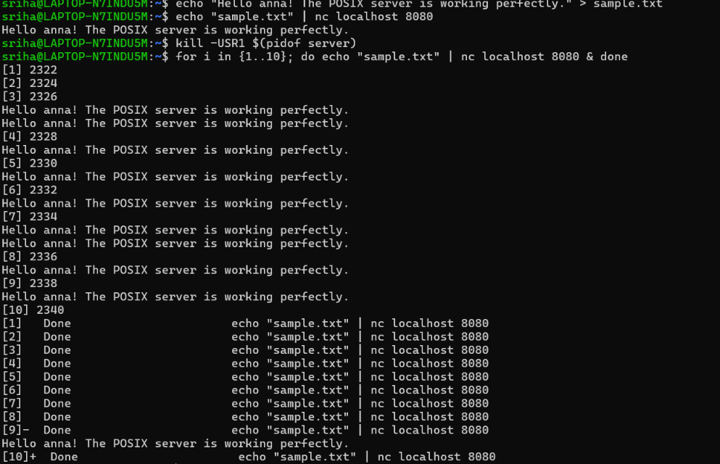
Demonstration — Concurrent Requests
10 simultaneous "nc" clients request the same file at once; every one gets the correct bytes back, and kill -USR1 confirms the server is alive and responding.
20

Slide 21
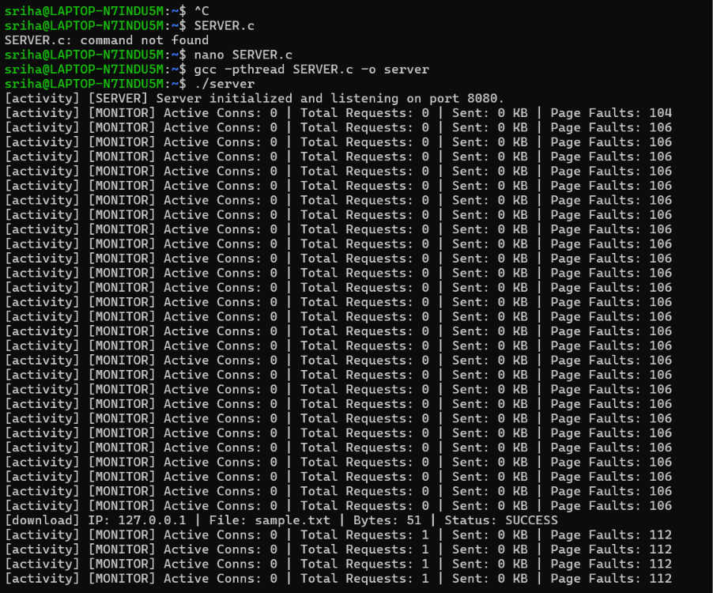
Demonstration — Build & Live Monitoring
gcc -pthread compiles the server; the monitor thread then prints live stats every second — active connections, total requests, bytes sent, and page faults — while a request completes.
21

Slide 22
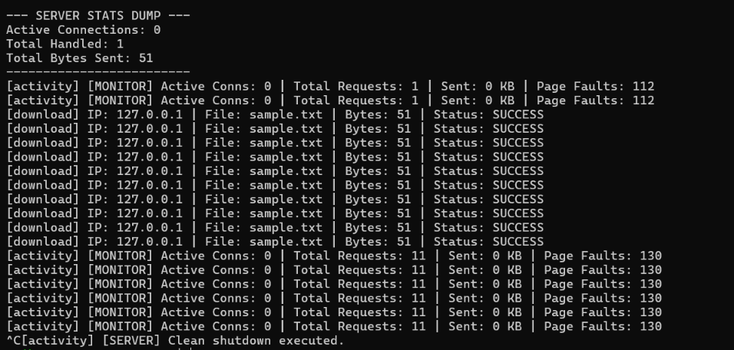
Demonstration — Stats Dump & Clean Shutdown
SIGUSR1 prints an on-demand stats dump (11 requests, 51 bytes served) without stopping the server; Ctrl+C (SIGINT) then shuts it down cleanly.
22

